Slide 1
JFC
The Java Foundation Classes (JFC) are a set of GUI components which simplify the development of desktop applications.

Slide 2
Java AWT (Abstract Window Toolkit)
Java AWT is an API to develop GUI (Graphical User Interface) or window-based application in java.
Java AWT components are platform-dependent i.e. components are displayed according to the view of operating system. AWT is heavyweight i.e. its components uses the resources of system.
It offers user interaction via some graphical components
The java.awt package provides classes for AWT api such as TextField, Label, TextArea, RadioButton, CheckBox, Choice, List etc.

Slide 3
Swing
It is a part of Java Foundation Classes (JFC) that is used to create window-based applications.
It is used to create window-based applications.
It is built on the top of AWT (Abstract Windowing Toolkit) API and entirely written in java.
It acts as replacement of AWT API as it has almost every control corresponding to AWT controls.
Java Swing provides platform-independent and lightweight components
The javax.swing package provides classes for java swing API such as JButton, JTextField, JTextArea, JRadioButton, JCheckbox, JMenu, JColorChooser etc.

Slide 4
Contd…
Swing API is set of extensible GUI Components to ease developer's life to create JAVA based Front End/ GUI Applications.
Swing component follows a Model-View-Controller architecture to fulfill the following criteria’s.
A single API is to be sufficient to support multiple look and feel.
API is to model driven so that highest level API is not required to have the data.
API is to use the Java Bean model so that Builder Tools and IDE can provide better services to the developers to use it.

Slide 5
Swing features
Light Weight - Swing component are independent of native Operating System's API as Swing API controls are rendered mostly using pure JAVA code instead of underlying operating system calls.
Rich controls - Swing provides a rich set of advanced controls like Tree, TabbedPane, slider, color picker, table controls.
Highly Customizable - Swing controls can be customized in very easy way as visual appearance is independent of internal representation.
Pluggable look-and-feel- SWING based GUI Application look and feel can be changed at run time based on available values.

Slide 6
Difference between AWT and Swing
Java AWT | Java Swing
AWT components are platform-dependent. | Java swing components are platform-independent.
AWT components are heavyweight. | Swing components are lightweight.
AWT doesn't support pluggable look and feel. | Swing supports pluggable look and feel.
AWT provides less components than Swing. | Swing provides more powerful components such as tables, lists, scrollpanes, colorchooser, tabbedpane etc.
AWT doesn't follows MVC(Model View Controller) where model represents data, view represents presentation and controller acts as an interface between model and view. | Swing follows MVC.

Slide 7
Components
All the elements like the button, text fields, scroll bars, etc. are called components.
In Java AWT, there are classes for each component as shown in above diagram. In order to place every component in a particular position on a screen, we need to add them to a container.
Container
The Container is a component in AWT that can contain another components like buttons, textfields, labels etc. The classes that extends Container class are known as container such as Frame, Dialog and Panel.
It is basically a screen where the where the components are placed at their specific locations. Thus it contains and controls the layout of components. There are four types of containers in Java AWT:
Window
Panel
Frame
Dialog

Slide 8
Window
The window is the container that have no borders and menu bars. You must use frame, dialog or another window for creating a window. We need to create an instance of Window class to create this container.
Panel
The Panel is the container that doesn't contain title bar, border or menu bar. It is generic container for holding the components.
It can have other components like button, text field etc. An instance of Panel class creates a container, in which we can add components.
Frame
The Frame is the container that contain title bar and border and can have menu bars. It can have other components like button, text field, scrollbar etc. Frame is most widely used container while developing an AWT application.

Slide 9
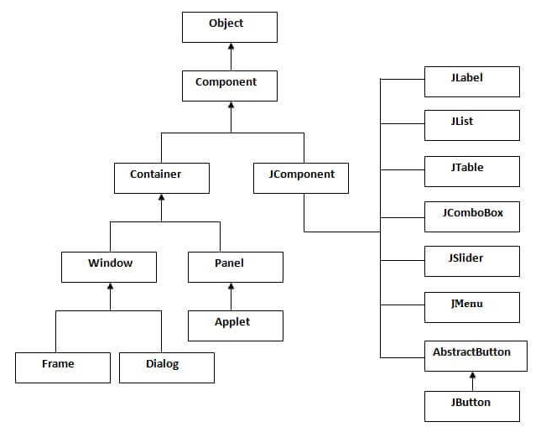
Hierarchy Of Java Swing Classes

Slide 10
Common Methods Of Component Class
Method | Description
public void add(Component c) | add a component on another component.
public void setSize(int width,int height) | sets size of the component.
public void setLayout(LayoutManager m) | sets the layout manager for the component.
public void setVisible(boolean b) | sets the visibility of the component. It is by default false.

Slide 11
Cont…
There are two ways to create a frame:
By creating the object of Frame class (association)
By extending Frame class (inheritance)
We can write the code of swing inside the main(), constructor or any other method.

Slide 12
Simple Java Swing Example
import javax.swing.*;
public class FirstSwingExample {
public static void main(String[] args) {
JFrame f=new JFrame();//creating instance of JFrame
JButton b=new JButton("click");//creating instance of JButton
b.setBounds(130,100,100, 40);//x axis, y axis, width, height
f.add(b);//adding button in JFrame
f.setSize(400,500);//400 width and 500 height
f.setLayout(null);//using no layout managers
f.setVisible(true);//making the frame visible
}
}

Slide 13
Swing by Association inside constructor
import javax.swing.*;
public class Simple {
JFrame f;
Simple(){
f=new JFrame();//creating instance of JFrame
JButton b=new JButton("click");//creating instance of JButton
b.setBounds(130,100,100, 40);
f.add(b);//adding button in JFrame
f.setSize(400,500);//400 width and 500 height
f.setLayout(null);//using no layout managers
f.setVisible(true);//making the frame visible
}
public static void main(String[] args) {
new Simple();
} }

Slide 14
Simple example of Swing by inheritance
import javax.swing.*;
public class Simple2 extends JFrame{//inheriting JFrame
JFrame f;
Simple2(){
JButton b=new JButton("click");//create button
b.setBounds(130,100,100, 40);
add(b);//adding button on frame
setSize(400,500);
setLayout(null);
setVisible(true);
}
public static void main(String[] args) {
new Simple2();
}}

Slide 15
JFrame
The javax.swing.JFrame class is a type of container which inherits the java.awt.Frame class.
JFrame works like the main window where components like labels, buttons, textfields are added to create a GUI.
Unlike Frame, JFrame has the option to hide or close the window with the help of setDefaultCloseOperation(int) method.

Slide 16
Constructor | Description
JFrame() | It constructs a new frame that is initially invisible.
JFrame(GraphicsConfiguration gc) | It creates a Frame in the specified GraphicsConfiguration of a screen device and a blank title.
JFrame(String title) | It creates a new, initially invisible Frame with the specified title.
JFrame(String title, GraphicsConfiguration gc) | It creates a JFrame with the specified title and the specified GraphicsConfiguration of a screen device.

Slide 17
Jlabel
The object of JLabel class is a component for placing text in a container.
It is used to display a single line of read only text.
The text can be changed by an application but a user cannot edit it directly.
It inherits JComponent class.

Slide 18
Constructors
Constructor | Description
JLabel() | Creates a JLabel instance with no image and with an empty string for the title.
JLabel(String s) | Creates a JLabel instance with the specified text.
JLabel(Icon i) | Creates a JLabel instance with the specified image.
JLabel(String s, Icon i, int horizontalAlignment) | Creates a JLabel instance with the specified text, image, and horizontal alignment.

Slide 19
Methods
Methods | Description
String getText() | t returns the text string that a label displays.
void setText(String text) | It defines the single line of text this component will display.
void setHorizontalAlignment(int alignment) | It sets the alignment of the label's contents along the X axis.
Icon getIcon() | It returns the graphic image that the label displays.
int getHorizontalAlignment() | It returns the alignment of the label's contents along the X axis.

Slide 20
JTextField
The object of a JTextField class is a text component that allows the editing of a single line text. It inherits JTextComponent class.
Constructor | Description
JTextField() | Creates a new TextField
JTextField(String text) | Creates a new TextField initialized with the specified text.
JTextField(String text, int columns) | Creates a new TextField initialized with the specified text and columns.
JTextField(int columns) | Creates a new empty TextField with the specified number of columns.

Slide 21
Commonly used Methods
Methods | Description
void addActionListener(ActionListener l) | It is used to add the specified action listener to receive action events from this textfield.
Action getAction() | It returns the currently set Action for this ActionEvent source, or null if no Action is set.
void setFont(Font f) | It is used to set the current font.
void removeActionListener(ActionListener l) | It is used to remove the specified action listener so that it no longer receives action events from this textfield.

Slide 22
JPasswordField
The object of a JPasswordField class is a text component specialized for password entry. It allows the editing of a single line of text. It inherits JTextField class.
Constructor | Description
JPasswordField() | Constructs a new JPasswordField, with a default document, null starting text string, and 0 column width.
JPasswordField(int columns) | Constructs a new empty JPasswordField with the specified number of columns.
JPasswordField(String text) | Constructs a new JPasswordField initialized with the specified text.
JPasswordField(String text, int columns) | Construct a new JPasswordField initialized with the specified text and columns.

Slide 23
JButton
The JButton class is used to create a labeled button that has platform independent implementation.
The application result in some action when the button is pushed.
It inherits AbstractButton class.

Slide 24
Constructor
Constructor | Description
JButton() | It creates a button with no text and icon.
JButton(String s) | It creates a button with the specified text.
JButton(Icon i) | It creates a button with the specified icon object.

Slide 25
Methods Of AbstractButton Class
Methods | Description
void setText(String s) | It is used to set specified text on button
String getText() | It is used to return the text of the button.
void setEnabled(boolean b) | It is used to enable or disable the button.
void setIcon(Icon b) | It is used to set the specified Icon on the button.
Icon getIcon() | It is used to get the Icon of the button.
void setMnemonic(int a) | It is used to set the mnemonic on the button.
void addActionListener(ActionListener a) | It is used to add the action listener to this object.

Slide 26
Event Handling
Event Handling is the mechanism that controls the event and decides what should happen if an event occurs.
This mechanism have the code which is known as event handler that is executed when an event occurs.
Java Uses the Delegation Event Model to handle the events. This model defines the standard mechanism to generate and handle the events.
In this model, a source generates an event and sends it to one or more listeners. The listener simply waits until it receives an event.
Once an event is received, the listener processes the event and then returns.
The benefit of this approach is that the user interface logic is completely separated from logic that generates the event.
In Delegation model listener needs to be registered with the source object so that the listener can receive the event notification.

Slide 27
This is an efficient way of handling the event because the event notifications are sent only to those listeners that want to receive them.
Following steps are required to perform event handling
Implement the Listener interface and overrides its methods
Register the component with the Listener
Put proper code in required overridden method
It contains Events, Event Sources and Event handling
Event: an event is an object that describes a state change in a source. It can be generated as a consequences of a user interacting with the elements in GUI.
Event Sources: a source is an object that generates an event. This occurs when the internal state of that object changes in some way. Sources may generate more than one type of event. Event sources are Button, Combo boxes etc.
Event listeners: to react to an event, we need to implement appropriate event handling. A listener is an object that is notified when an event occurs. Some are ActionListener, KeyListener etc

Slide 28
Key Event Classes
EventObject class which is the superclass for all event classes.
AWTEvent, a subclass of EventObject, is a superclass of all AWT events that are handled by the delegation model.

Slide 29
Event Classes | Description
ActionEvent | Generated when a button is pressed, a list item is double-clicked, or a menu item is selected
MouseEvent | Generated when mouse is dragged, moved, clicked, pressed or released. Also generated when the mouse enters or exit a component.
MouseWheelEvent | Generated when the mouse wheel is moved
KeyEvent | Generated when input is received from the keyboard.
ItemEvent | Generated when a check box, list item or checkable menu item is selected
TextEvent | Generated when the value of a text area or text field is changed.
WindowEvent | Generated when a window is activated, closed,deactivated,open or quit.
ComponentEvent | Generated when a component is hidden, moved, resized or becomes visible.
ContainerEvent | Generated when a component is added to or removed from container.
FocusEvent | Generated when a component gains or losses keyboard focus

Slide 30
Event Listener Interfaces
To handle events we must implement event listener interfaces. It has two major requirements.
First, it must have been registered with one or more sources to receive notifications about specific types of events. Second, it must implement methods to receive and process these notifications.
The event listener interfaces and their corresponding method declarations are.

Slide 31
Listener Interfaces | Description
ActionListener | Declares one method to receive action events. Action events are generated when button is pressed
MouseListener and MouseMotionListener | Defines five methods to recongnize when the mouse is clicked, enters a component, exits a component, is pressed or released. void mouseClicked(MouseEvent me) void mouseEntered(MouseEvent me) void mouseExited(MouseEvent me) void mousePressed(MouseEvent me) void mouseReleased(MouseEvent me)
MouseWheelListener | MouseWheelListener
KeyListener | KeyListener
ItemListener | ItemListener
TextListener | TextListener
AdjustmentListener | AdjustmentListener
WindowListener | WindowListener
ComponentListener | ComponentListener
ContainerListener | ContainerListener
FocusListener | FocusListener

Slide 32
Registration Methods
Button
public void addActionListener(ActionListener a){}
MenuItem
public void addActionListener(ActionListener a){}
TextField
public void addActionListener(ActionListener a){}
public void addTextListener(TextListener a){}
TextArea
public void addTextListener(TextListener a){}
Checkbox
public void addItemListener(ItemListener a){}
Choice
public void addItemListener(ItemListener a){}
List
public void addActionListener(ActionListener a){}
public void addItemListener(ItemListener a){}

Slide 33
Java Event Handling Code
After implementing the required listener interface and registering the source object with listener, it is the responsibility of programmer to provide proper event handler code within the listener method that is overridden by our event handler class.
We can put the event handling code into one of the following places:
Same class
Outer class
Inner class

Slide 34
Java Event Classes And Listener Interfaces
Event Classes | Listener Interfaces
ActionEvent | ActionListener
MouseEvent | MouseListener and MouseMotionListener
MouseWheelEvent | MouseWheelListener
KeyEvent | KeyListener
ItemEvent | ItemListener
TextEvent | TextListener
AdjustmentEvent | AdjustmentListener
WindowEvent | WindowListener
ComponentEvent | ComponentListener
ContainerEvent | ContainerListener
FocusEvent | FocusListener

Slide 35
Java Event Handling Code
After implementing the required listener interface and registering the source object with listener, it is the responsibility of programmer to provide proper event handler code within the listener method that is overridden by our event handler class.
We can put the event handling code into one of the following places:
Same class
Outer class
Inner class

Slide 36
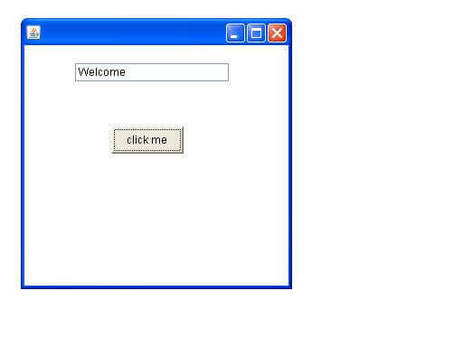
Java Event Handling Within Class By Implementing ActionListener
import javax.swing.*;
import java.awt.event.*;
class AEvent extends JFrame implements ActionListener{ JTextField tf;
AEvent(){
tf=new JTextField();
tf.setBounds(60,50,170,20);
JButton b=new JButton("click me");
b.setBounds(100,120,80,30);
b.addActionListener(this);
add(b);add(tf);
setSize(300,300);
setLayout(null);
setVisible(true);
}
public void actionPerformed(ActionEvent e){
tf.setText("Welcome");
}
public static void main(String args[]){
new AEvent();
}
}

Slide 37
Java Event Handling By Outer Class By Implementing ActionListener
import javax.swing.*;
import java.awt.event.*;
class AEvent extends JFrame {
JTextField tf;
AEvent(){
tf=new JTextField();
tf.setBounds(60,50,170,20);
JButton b=new JButton("click me");
b.setBounds(100,120,80,30);
b.addActionListener(new Handler(this))
add(b);add(tf);
setSize(300,300);
setLayout(null);
setVisible(true);
}
}
public static void main(String args[]){
new AEvent();
} }
class Handler implements ActionListener {
AEvent ed
Handler(Aevent e){
ed=e;
}
public void actionPerformed(ActionEvent e){
ed.tf.setText("Welcome");
}
}

Slide 38
Java Event Handling By Anonymous(inner) Class By Implementing ActionListener
import javax.swing.*;
import java.awt.event.*;
class AEvent extends JFrame {
JTextField tf;
AEvent(){
tf=new JTextField();
tf.setBounds(60,50,170,20);
JButton b=new JButton("click me");
b.setBounds(100,120,80,30);
b.addActionListener(new Handler(this))
add(b);add(tf);
setSize(300,300);
setLayout(null); class
setVisible(true);
}
}
public static void main(String args[]){
new AEvent();
}
class Handler implements ActionListener {
public void actionPerformed(ActionEvent e)
{
ed.tf.setText("Welcome");
}
}
}

Slide 39
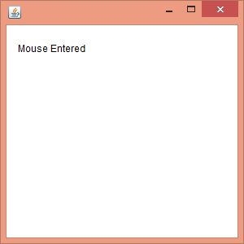
MouseListener Example
import java.awt.*;
import java.awt.event.*;
public class MouseListenerExample extends Frame implements MouseListener{
Label l;
MouseListenerExample(){
addMouseListener(this);
l=new Label();
l.setBounds(20,50,100,20);
add(l);
setSize(300,300);
setLayout(null);
setVisible(true);
}
public void mouseClicked(MouseEvent e) {
l.setText("Mouse Clicked");
}
public void mouseEntered(MouseEvent e) {
l.setText("Mouse Entered");
}
public void mouseExited(MouseEvent e) {
l.setText("Mouse Exited");
}
public void mousePressed(MouseEvent e) {
l.setText("Mouse Pressed");
}
public void mouseReleased(MouseEvent e) { l.setText("Mouse Released");
}
public static void main(String[] args) {
new MouseListenerExample();
}
}

Slide 40
ItemListener Interface
import java.awt.*;
import java.awt.event.*;
public class ItemListenerExample implements ItemListener{
Checkbox checkBox1,checkBox2;
Label label;
ItemListenerExample(){
Frame f= new Frame("CheckBox Example");
label = new Label();
label.setAlignment(Label.CENTER);
label.setSize(400,100);
checkBox1 = new Checkbox("C++");
checkBox1.setBounds(100,100, 50,50);
checkBox2 = new Checkbox("Java");
checkBox2.setBounds(100,150, 50,50);
f.add(checkBox1); f.add(checkBox2); f.add(label);
checkBox1.addItemListener(this);
checkBox2.addItemListener(this);
f.setSize(400,400);
f.setLayout(null);
f.setVisible(true);
}

Slide 41
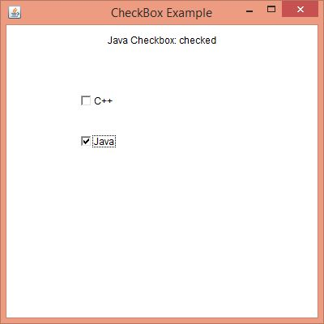
public void itemStateChanged(ItemEvent e) {
if(e.getSource()==checkBox1)
label.setText("C++ Checkbox: " + (e.getStateChange()==1?"checked":"unchecked"));
if(e.getSource()==checkBox2)
label.setText("Java Checkbox: " + (e.getStateChange()==1?"checked":"unchecked"));
}
public static void main(String args[])
{
new ItemListenerExample();
}
}

Slide 42
Java Adapter Classes
Java adapter classes provide the default implementation of listener interfaces.
If we inherit the adapter class, we will not be forced to provide the implementation of all the methods of listener interfaces. So it saves code.
In an adapter class, there is no need for implementation of all the methods presented in an interface.
It is used when only some methods of defined by its interface have to be overridden.
In a listener, all the methods that have been declared in its interface have to be implemented. These methods are

Slide 43
Adapter class | Listener interface
WindowAdapter | WindowListener
KeyAdapter | KeyListener
MouseAdapter | MouseListener
MouseMotionAdapter | MouseMotionListener
FocusAdapter | FocusListener
ComponentAdapter | ComponentListener
ContainerAdapter | ContainerListener

Slide 44
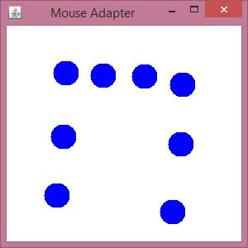
Java Mouseadapter Example
import java.awt.*;
import java.awt.event.*;
public class MouseAdapterExample extends MouseAdapter{
Frame f;
MouseAdapterExample(){
f=new Frame("Mouse Adapter");
f.addMouseListener(this);
f.setSize(300,300);
f.setLayout(null);
f.setVisible(true);
}
public void mouseClicked(MouseEvent e) {
Graphics g=f.getGraphics();
g.setColor(Color.BLUE);
g.fillOval(e.getX(),e.getY(),30,30);
}
public static void main(String[] args) {
new MouseAdapterExample();
} }

Slide 45
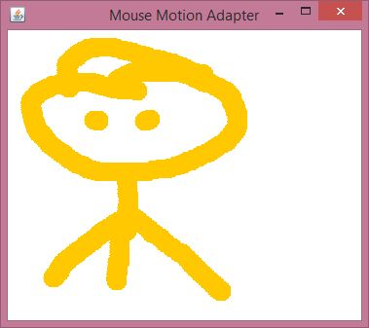
MouseMotionAdapter Example
import java.awt.*;
import java.awt.event.*;
public class MouseMotionAdapterExample extends MouseMotionAdapter{
Frame f;
MouseMotionAdapterExample(){
f=new Frame("Mouse Motion Adapter");
f.addMouseMotionListener(this);
f.setSize(300,300);
f.setLayout(null);
f.setVisible(true);
}
public void mouseDragged(MouseEvent e) {
Graphics g=f.getGraphics();
g.setColor(Color.ORANGE);
g.fillOval(e.getX(),e.getY(),20,20);
}
public static void main(String[] args) {
new MouseMotionAdapterExample();
}
}

Slide 46
Action Command
Action command is just a String that serves to identify the component that sent the event.
By default, the action command of a JButton is the same as its label; it is included in action events so that you could use it to figure out which button an event came from.
To get the action command from an action event, call the event’s getActionCommand() method.
You can change the action command by calling the button’s setActionCommand(“command”) method
public void actionPerformed(ActionEvent e){
if (e.getActionCommand().equals("Yes") {
//the user pressed "Yes"; do something
}
}

Slide 47
Action Command Example
import javax.swing.*;
import java.awt.event.*;
class AEvent extends JFrame implements ActionListener{
JTextField tf;
AEvent(){
tf=new JTextField();
tf.setBounds(60,50,170,20);
JButton b=new JButton("click me");
b.setActionCommand("FirstButton");
b.setBounds(100,120,80,30);
b.addActionListener(this);
add(b);add(tf);
setSize(300,300);
setLayout(null);
setVisible(true);
}
public void actionPerformed(ActionEvent e){
tf.setText("Welcome");
String str = event.getActionCommand();
System.out.println("Clicked = " + str);
}
public static void main(String args[]){
new AEvent();
}
}

Slide 48
Java Adapter Classes
Java adapter classes provide the default implementation of listener interfaces
. If you inherit the adapter class, you will not be forced to provide the implementation of all the methods of listener interfaces. So it saves code.
The adapter classes are found in java.awt.event, java.awt.dnd and javax.swing.event packages

Slide 49
Pros Of Using Adapter Classes
It assists the unrelated classes to work combinely.
It provides ways to use classes in different ways.
It increases the transparency of classes.
It provides a way to include related patterns in the class.
It provides a pluggable kit for developing an application.
It increases the reusability of the class.

Slide 50
Adapter Classes With Their Corresponding Listener Interfaces
java.awt.event Adapter classes
Adapter class | Listener interface
WindowAdapter | WindowListener
KeyAdapter | KeyListener
MouseAdapter | MouseListener
MouseMotionAdapter | MouseMotionListener
FocusAdapter | FocusListener
ComponentAdapter | ComponentListener
ContainerAdapter | ContainerListener
HierarchyBoundsAdapter | HierarchyBoundsListener

Slide 51
java.awt.dnd Adapter classes
Adapter class | Listener interface
DragSourceAdapter | DragSourceListener
DragTargetAdapter | DragTargetListener
javax.swing.event Adapter classes
Adapter class | Listener interface
MouseInputAdapter | MouseInputListener
InternalFrameAdapter | InternalFrameListener

Slide 52
import java.awt.*;
import java.awt.event.*;
public class AdapterExample {
Frame f;
AdapterExample() {
f = new Frame ("Window Adapter");
f.addWindowListener (new WindowAdapter() {
public void windowClosing (WindowEvent e) {
f.dispose();
}
});
f.setSize (400, 400);
f.setLayout (null);
f.setVisible (true);
}
public static void main(String[] args) {
new AdapterExample();
}
}

Slide 53
import java.awt.*;
import java.awt.event.*;
public class MouseAdapterExample extends MouseAdapter {
Frame f;
MouseAdapterExample() {
f = new Frame ("Mouse Adapter");
f.addMouseListener(this);
f.setSize (300, 300);
f.setLayout (null);
f.setVisible (true);
}
public void mouseClicked (MouseEvent e) {
Graphics g = f.getGraphics();
g.setColor (Color.BLUE);
g.fillOval (e.getX(), e.getY(), 30, 30);
}
public static void main(String[] args) {
new MouseAdapterExample();
}
}

Slide 54
Layout Management
The LayoutManagers are used to arrange components in a particular manner. LayoutManager is an interface that is implemented by all the classes of layout managers. There are following classes that represents the layout managers:
java.awt.BorderLayout
java.awt.FlowLayout
java.awt.GridLayout
java.awt.GridBagLayout
java.awt.GroupLayout

Slide 55
BorderLayout
The BorderLayout is used to arrange the components in five regions: north, south, east, west, and center.
Each region (area) may contain one component only. It is the default layout of a frame or window. The BorderLayout provides five constants for each region:
public static final int NORTH
public static final int SOUTH
public static final int EAST
public static final int WEST
public static final int CENTER

Slide 56
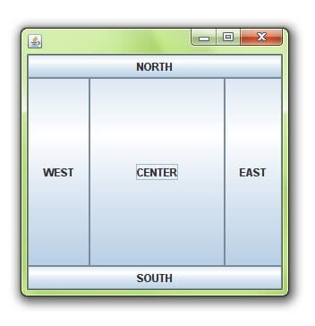
BorderLayout
import java.awt.*;
import javax.swing.*;
public class Border {
JFrame f;
Border(){
f=new JFrame();
JButton b1=new JButton("NORTH");
JButton b2=new JButton("SOUTH");
JButton b3=new JButton("EAST");
JButton b4=new JButton("WEST");
JButton b5=new JButton("CENTER");
f.add(b1,BorderLayout.NORTH);
f.add(b2,BorderLayout.SOUTH);
f.add(b3,BorderLayout.EAST);
f.add(b4,BorderLayout.WEST);
f.add(b5,BorderLayout.CENTER);
f.setSize(300,300);
f.setVisible(true);
}
public static void main(String[] args) {
new Border();
} }

Slide 57
GridLayout
The Java GridLayout class is used to arrange the components in a rectangular grid. One component is displayed in each rectangle.
GridLayout(): creates a grid layout with one column per component in a row.
GridLayout(int rows, int columns): creates a grid layout with the given rows and columns but no gaps between the components.
GridLayout(int rows, int columns, int hgap, int vgap): creates a grid layout with the given rows and columns along with given horizontal and vertical gaps.

Slide 58
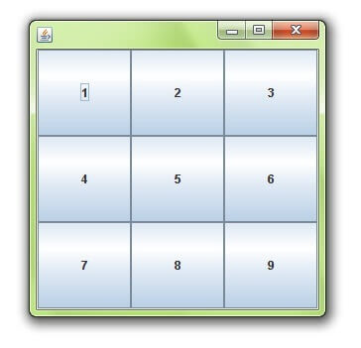
GridLayout
import java.awt.*;
import javax.swing.*;
public class MyGridLayout{
JFrame f;
MyGridLayout(){
f=new JFrame();
JButton b1=new JButton("1");
JButton b2=new JButton("2");
JButton b3=new JButton("3");
JButton b4=new JButton("4");
JButton b5=new JButton("5");
JButton b6=new JButton("6");
JButton b7=new JButton("7");
JButton b8=new JButton("8");
JButton b9=new JButton("9");
f.add(b1);f.add(b2);f.add(b3);f.add(b4);f.add(b5);
f.add(b6);f.add(b7);f.add(b8);f.add(b9);
f.setLayout(new GridLayout(3,3));
f.setSize(300,300);
f.setVisible(true);
}
public static void main(String[] args) {
new MyGridLayout();
}
}

Slide 59
FlowLayout
The Java FlowLayout class is used to arrange the components in a line, one after another (in a flow). It is the default layout of the applet or panel. Fields of FlowLayout class
public static final int LEFT, public static final int RIGHT
public static final int CENTER, public static final int LEADING
public static final int TRAILING
Constructors of FlowLayout class
FlowLayout(): creates a flow layout with centered alignment and a default 5 unit horizontal and vertical gap.
FlowLayout(int align): creates a flow layout with the given alignment and a default 5 unit horizontal and vertical gap.
FlowLayout(int align, int hgap, int vgap): creates a flow layout with the given alignment and the given horizontal and vertical gap.

Slide 60
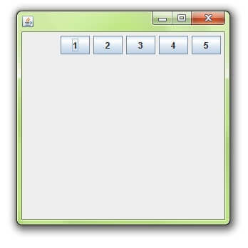
FlowLayout
import java.awt.*;
import javax.swing.*;
public class MyFlowLayout{
JFrame f;
MyFlowLayout(){
f=new JFrame();
JButton b1=new JButton("1");
JButton b2=new JButton("2");
JButton b3=new JButton("3");
JButton b4=new JButton("4");
JButton b5=new JButton("5");
f.add(b1);f.add(b2);f.add(b3);f.add(b4);f.add(b5);
f.setLayout(new FlowLayout(FlowLayout.RIGHT)); f.setSize(300,300);
f.setVisible(true);
}
public static void main(String[] args) {
new MyFlowLayout();
}
}

Slide 61
GridBagLayout
This is the most flexible layout manager class.
The object of GridBagLayout aligns the component vertically, horizontally, or along their baseline without requiring the components of the same size.
The components may not be of the same size. Each GridBagLayout object maintains a dynamic, rectangular grid of cells.
Each component occupies one or more cells known as its display area. Each component associates an instance of GridBagConstraints.

Slide 62
import java.awt.*;
import javax.swing.*;
public class GridBagLayoutExample extends JFrame{
public static void main(String[] args) {
GridBagLayoutExample a = new GridBagLayoutExample(); }
public GridBagLayoutExample() {
GridBagLayoutgrid = new GridBagLayout();
GridBagConstraints gbc = new GridBagConstraints(); setLayout(grid);
setTitle("GridBag Layout Example");
GridBagLayout layout = new GridBagLayout();
this.setLayout(layout);
gbc.fill = GridBagConstraints.HORIZONTAL;
gbc.gridx = 0;
gbc.gridy = 0;
this.add(new Button("Button One"), gbc);
gbc.gridx = 1;
gbc.gridy = 0;
this.add(new Button("Button two"), gbc);
gbc.fill = GridBagConstraints.HORIZONTAL;
gbc.ipady = 20;
gbc.gridx = 0;
gbc.gridy = 1;
this.add(new Button("Button Three"), gbc);
gbc.gridx = 1;
gbc.gridy = 1;
this.add(new Button("Button Four"), gbc);
gbc.gridx = 0;
gbc.gridy = 2;
gbc.fill = GridBagConstraints.HORIZONTAL;
gbc.gridwidth = 2;
this.add(new Button("Button Five"), gbc);
setSize(300, 300);
setPreferredSize(getSize());
setVisible(true);
setDefaultCloseOperation(EXIT_ON_CLOSE);
}
}

Slide 63
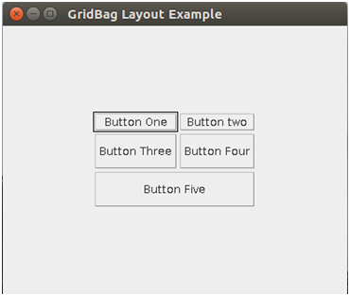

Slide 64
GroupLayout
GroupLayout groups its components and places them in a Container hierarchically. The grouping is done by instances of the Group class.
Group is an abstract class, and two concrete classes which implement this Group class are SequentialGroup and ParallelGroup.
SequentialGroup positions its child sequentially one after another whereas ParallelGroup aligns its child on top of each other.
The GroupLayout class provides methods such as createParallelGroup() and createSequentialGroup() to create groups.
GroupLayout treats each axis independently. That is, there is a group representing the horizontal axis, and a group representing the vertical axis.
Each component must exist in both a horizontal and vertical group, otherwise an IllegalStateException is thrown during layout or when the minimum, preferred, or maximum size is requested.

Slide 65

import java.awt.*;
import javax.swing.*;
public class GroupExample {
public static void main(String[] args) {
JFrame frame = new JFrame("GroupLayoutExample");
frame.setDefaultCloseOperation(JFrame.EXIT_ON_CLOSE);
Container contentPanel = frame.getContentPane();
GroupLayout groupLayout = new GroupLayout(contentPanel);
contentPanel.setLayout(groupLayout);
JLabel clickMe = new JLabel("Click Here");
JButton button = new JButton("This Button");
groupLayout.setHorizontalGroup(
groupLayout.createSequentialGroup()
addComponent(clickMe)
.addGap(10, 20, 100)
.addComponent(button));
groupLayout.setVerticalGroup(
groupLayout.createParallelGroup( GroupLayout.Alignment.BASELINE)
.addComponent(clickMe)
.addComponent(button));
frame.pack();
frame.setVisible(true);
}
}

Slide 66
2D Shape
“Graphics,” class that will allow us to call basic 2D shapes that can be drawn to a window.
Graphics is an abstract class provided by Java AWT which is used to draw or paint on the components.
The “JFrame,” class that allows for us to create a regular window to draw our shapes to the screen.
The “Canvas,” extension which allows for us to use the paint function to make it easier to draw the shapes to the screen.
The Canvas class controls and represents a blank rectangular area where the application can draw or trap input events from the user. It inherits the Component class.
Graphics object manages graphics context .Controls how information is drawn.
Class JComponent contains method paintComponent, which is used to draw graphics on a component.

Slide 67
Contd…
Graphics context
-Enables drawing on screen
-Graphics object manages graphics context .Controls how information is drawn
-Class Graphics is abtract
.Cannot be instantiated
.Contributes to Java's portability
Class Component method paint takes Graphics object
public void paint (Graphics g)
-Called through method repaint
Class Color
-Defines methods and constants for manipulating colors
-Colors are created from red, green and blue components
.RGB values

Slide 68
import java.awt.*;
import javax.swing.JFrame;
public class DisplayGraphics extends Canvas{
public void paint(Graphics g) {
g.drawString("Hello",40,40);
setBackground(Color.WHITE);
g.fillRect(130, 30,100, 80);
g.drawOval(30,130,50, 60);
setForeground(Color.RED);
g.fillOval(130,130,50, 60);
g.drawArc(30, 200, 40,50,90,60);
g.fillArc(30, 130, 40,50,180,40);
g.drawString("Welcome to Advance java", 150, 150);
}
public static void main(String[] args) {
DisplayGraphics m=new DisplayGraphics();
JFrame f=new JFrame();
f.add(m);
f.setSize(400,400);
f.setVisible(true);
} }

Slide 69
public class TwoDExample extends Canvas //JComponent
{
public void paint(Graphics g){
Font font = new Font(Font.SANS_SERIF, Font.BOLD, 20);
g.setFont(font);
g.setColor(Color.GRAY);
g.drawString("Welcome to Advance java", 150, 150);
}
public static void main(String[] args){
TwoDExample t = new TwoDExample();
JFrame frame = new JFrame("Custom component");
frame.add(t);
frame.setSize(500, 500);
frame.setVisible(true);
frame.setLayout(null);
}
}

Slide 70
Displaying Image
For displaying image, we can use the method drawImage() of Graphics class.
The javax.imageio.ImageIO class similarly provides several static read() methods that can load images from a File, URL, or InputStream:
Once we have an Image object, we can draw it into a graphics context with the drawImage() method of the Graphics class. The simplest form of the drawImage() method
public abstract boolean drawImage(Image img, int x, int y, ImageObserver observer): is used draw the specified image.

Slide 71
Contd…
From URL
URL daffyURL = getClass().getResource("/cartoons/images/daffy.gif");
Image daffyDuckImage = ImageIO.read( daffyURL );
From file
File imagefile = new File("C://My Documents/My Pictures/loan.PNG");
image = ImageIO.read(imagefile); g.drawImage( image, x, y, this );

Slide 72
Preloading Images
ImageIcon icon = new ImageIcon("myimage.jpg");
Image image = icon.getImage();

Slide 73
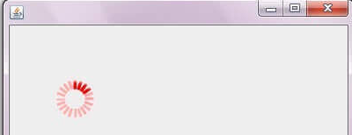
import java.awt.*;
import javax.swing.JFrame;
public class MyCanvas extends Canvas{
public void paint(Graphics g) {
ImageIcon icon = new ImageIcon("myimage.jpg");
Image i= icon.getImage();
//Toolkit t=Toolkit.getDefaultToolkit();
//Image i=t.getImage("p3.gif");
g.drawImage(i, 120,100,this);
}
public static void main(String[] args) {
MyCanvas m=new MyCanvas();
JFrame f=new JFrame();
f.add(m);
f.setSize(400,400);
f.setVisible(true);
}
}

Slide 74
MVC Architecture
The Model-View-Controller (MVC) is a well-known design pattern in the web development field.
It specifies that a program or application shall consist of data model, presentation information and control information.
The MVC pattern needs all these components to be separated as different objects.
Model: It represents the business layer of application. It is an object to carry the data that can also contain the logic to update controller if data is changed.
View: It represents the presentation layer of application. It is used to visualize the data that the model contains.
Controller: It works on both the model and view. It is used to manage the flow of application, i.e. data flow in the model object and to update the view whenever data is changed.

Slide 75
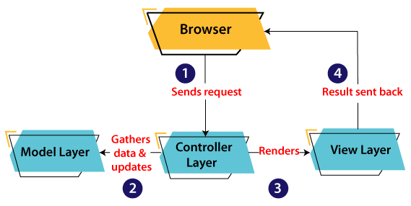

Slide 76
Contd…
A client (browser) sends a request to the controller on the server side, for a page.
The controller then calls the model. It gathers the requested data.
Then the controller transfers the data retrieved to the view layer.
Now the result is sent back to the browser (client) by the view.

Slide 77
Advantages Of MVC Architecture
MVC has the feature of scalability that in turn helps the growth of application.
The components are easy to maintain because there is less dependency.
A model can be reused by multiple views that provides reusability of code.
The developers can work with the three layers (Model, View, and Controller) simultaneously.
Using MVC, the application becomes more understandable.
Using MVC, each layer is maintained separately therefore we do not require to deal with massive code.
The extending and testing of application is easier.

